Slide 1

Used Laptops Data Analysis
Title: Used Laptops Data Analysis
Subtitle: Refurbished
Institution: Innomatics Reseach Labs
Batch: 397
Presented by:
YEDEEDYA INJETI

Slide 2
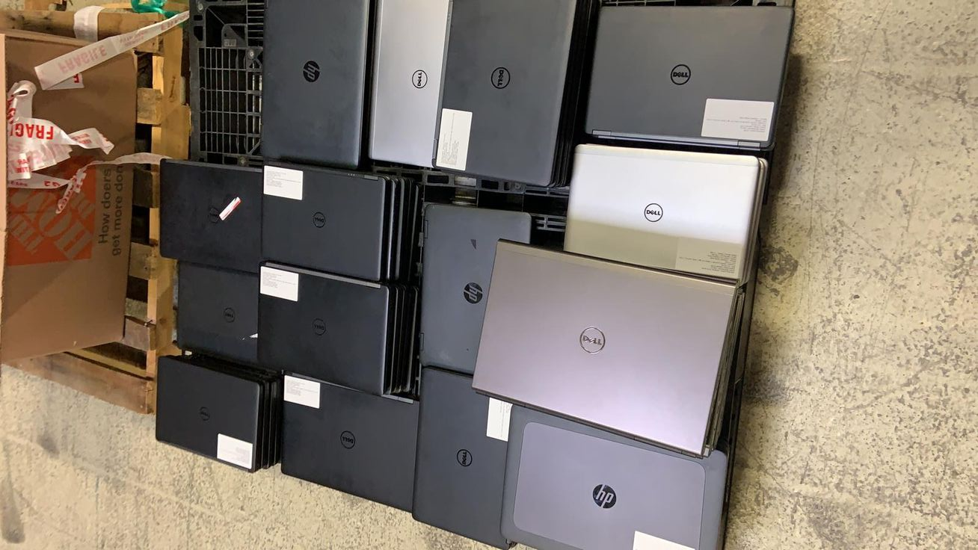
Work Flow
1
2
3
4
5
Web Scraping
Data Extraction
Data Cleaning
Dropping unwanted
Columns
Missing Values
Treatement
6
7
8
Analysis
Plots
Stats
Web Scraping: Collect data from websites using requests and BeautifulSoup.
Data Extraction: Use string operations (split(), upper(), replace()) and regex for pattern matching.
Column Drop: Remove unnecessary columns used for intermediate processing (e.g., raw spec column, split lists)
Missing Values Treatment: Fill missing categorical values with mode. Fill missing numeric values with mean, median .
Data Analysis: Explore data using summary statistics: count, mean, min, max
Statistics: Skewness Kurtosis Pivot tables & aggregations

Slide 3
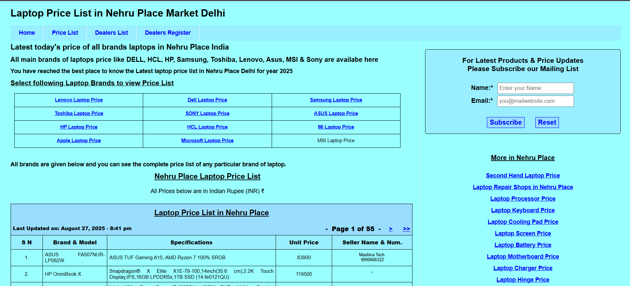
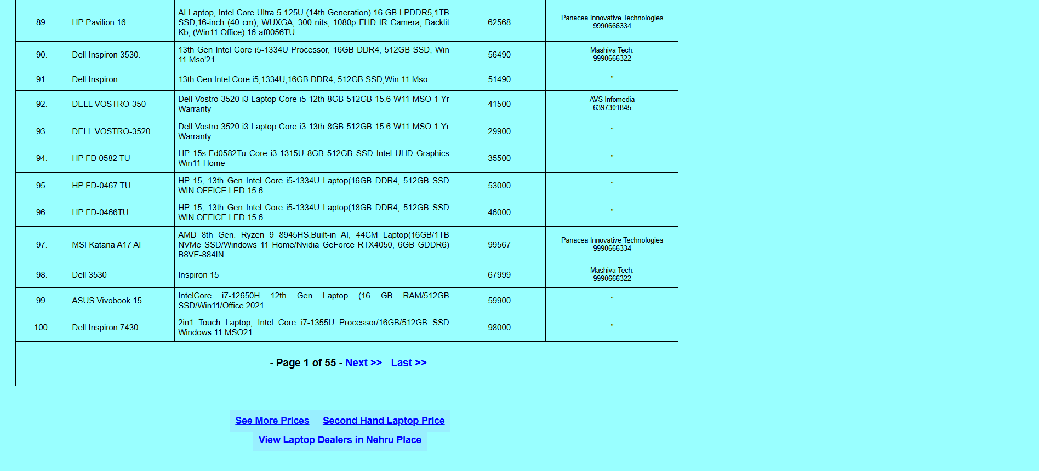
Website:

Slide 4
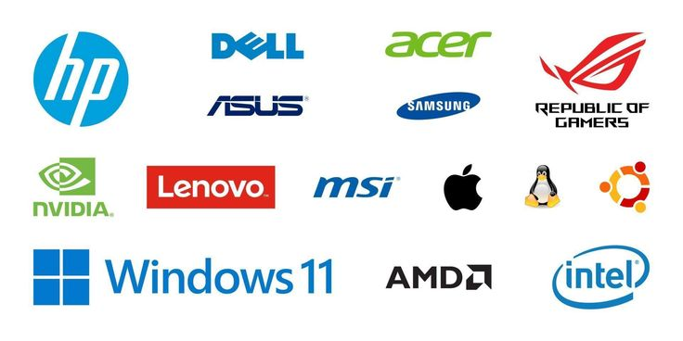
Data Extraction:
The raw dataset contains three main columns, where one column combines brand, model, processor, RAM, storage, and GPU specifications
into a single text field. The other columns include the seller information and the unit price of each laptop, often requiring extraction and cleaning
for analysis.
https://www.nehruplacemarket.com/laptop-price/laptop-price.php
Raw Csv File
Brand & Model + Spec
Unit - Price
Brand
Model
Unit - Price
Processor
Ram
Storage
GPU
MotherBard

Slide 5
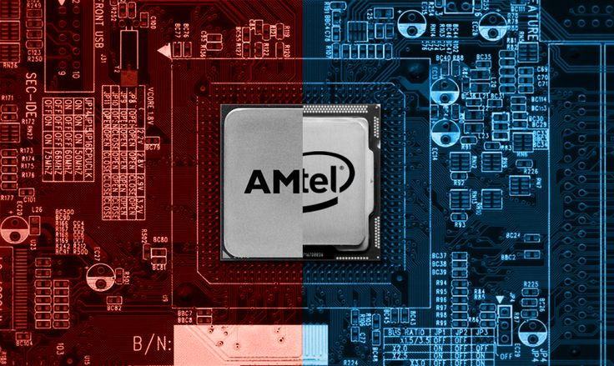




1. Brand:
Extracts the brand name from the Brand & Model + Spec column
Convert text to uppercase
Split text into words
Take the first word as the brand
Brand & Model + Spec | Brand
HP Pavilion 15 8GB RAM i5 | HP
Dell Inspiron 14 i7 | DELL
Lenovo ThinkPad X1 Carbon | LENOVO
HP., HPK, PAVILION | HP
INSPIRON | DELL
LENOV0, LENOVA, THINKBOOK | LENOVO
ASUS., ASUS, | ASUS
VAIO | SONY
M4, MAC | APPLE
XIOAMI, MI | XIAOMI
2. Model:
Second word from Brand & Model + Spec
Brand & Model + Spec | Brand | Model
HP Pavilion 15 8GB RAM i5 | HP | PAVILION
Dell Inspiron 14 i7 | DELL | INSPIRON
Lenovo ThinkPad X1 Carbon | LENOVO | THINKPAD
3. Processor:
Using a list of patterns and checks each spec string for matches from processor patterns (e.g., I5, I7, RYZEN 5).
If found → assigns the processor, else → Nan. Example
Brand & Model + Spec | Processor
HP Pavilion 15 8GB RAM i5 | I5
Lenovo ThinkPad Ryzen 5 | RYZEN 5
Acer Aspire 8GB RAM | NaN

Slide 6
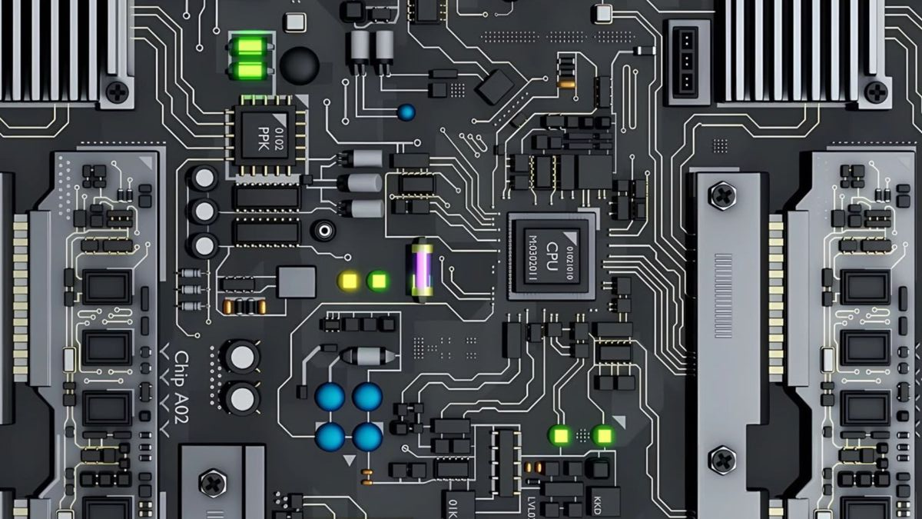



4. Ram:
Using a list of patterns and checks each spec string for matches from ram patterns (e.g., 8gb, 16gb, 32gb).
If found → assigns the ram, else → Nan. Example
Brand & Model + Spec | RAM Size
HP Pavilion 15 8GB RAM i5 | 8GB
Dell Inspiron 16GB RAM i7 | 16GB
Acer Aspire i3 | NaN
5. GPU:
Finds GPU from gpu patterns. if none found → assigns "Integrated"
"HP Pavilion 15 GTX 1650" → GPU: GTX 1650
6. Motherboards:
Checks for keywords from motherboard; if found → "Yes", else → "No".
Brand & Model + Spec | Motherboard
HP Pavilion 15 i5 GTX 1650 | No
Asus ROG Ryzen 7 H510 | Yes
Dell Inspiron 16GB RAM i7 | No
7. Unit Price:
Removed non-numeric characters.
Converted to numeric.
Replaced 0 and 1 with NaN.

Slide 7



Data Cleaning:
Converted Storage Size values to lowercase. Replaced whitespace with underscores. Removed all special characters (keeping only letters, numbers, _).
Brand
Unit Price cleaning:
Removed all non-numeric characters.
Converted to numeric (invalid → Nan).
Replaced 0 and 1 with Nan.
str.lower()
Model
Processor
str.replace(r'\s+', '_', regex=True)
Ram
str.replace(r'[^A-Za-z0-9_]','',regex = True)
Storage
Dropping unwanted columns:
Unwanted columns that are dropped during cleaning are
Column Name | Description / Reason for Dropping
Brand & Model + Spec | Original combined text column used for feature extraction
Spec_Upper | Uppercase version of the specs for processing
Spec_Split | List of split words from the specs column
Seller | Seller information which is not needed for EDA

Slide 8

Missing values treatment
Storage size and processor have the highest missing percentages (10% and 7%).
Ram with (2%)
Only unit price has a minor 1% missing values.
Column | Missing Values | Percentage
brand | 0 | 0%
model | 0 | 0%
processor | 255 | 7%
ram_size | 62 | 2%
storage_size | 355 | 10%
gpu | 0 | 0%
motherboard | 0 | 0%
unit_price | 42 | 1%
df[column'].fillna(df[column'].mode()[0])
Object datatype
df['unit_price'].astype('int')
Int datatype
df['unit_price'] = df['unit_price'].fillna(df['unit_price'].mean())
Non-Visuals analysis
Price range:
min 3250
max 1115001

Slide 9
Processors count:
i5 | i3 | i7 | ryzen_5 | ryzen_7 | ryzen_3 | m1 | i9 | m2 | dual_core | celeron | ultra_5 | ultra_7 | athlon | ryzen_9 | m4 | m3 | ultra_9 | snapdragon
1479 | 756 | 511 | 161 | 126 | 100 | 65 | 55 | 53 | 40 | 29 | 26 | 20 | 18 | 16 | 11 | 6 | 6 | 5
Ram count:
8_gb | 16_gb | 6_gb | 32_gb | 4_gb | 2_gb | 64_gb | 24_gb
1856 | 1151 | 167 | 110 | 83 | 72 | 38 | 6
Brand count:
hp | lenovo | dell | asus | apple | acer | msi | hcl | microsoft | samsung
1164 | 720 | 660 | 259 | 153 | 153 | 144 | 38 | 37 | 33
Storage count:
512_gb | 1_tb | 256_gb | 500_gb | 128_gb | 2_tb | hdd | ssd
2322 | 617 | 248 | 239 | 19 | 15 | 13 | 10

Slide 10
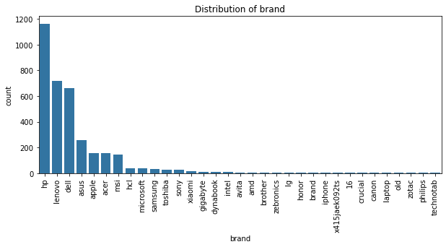
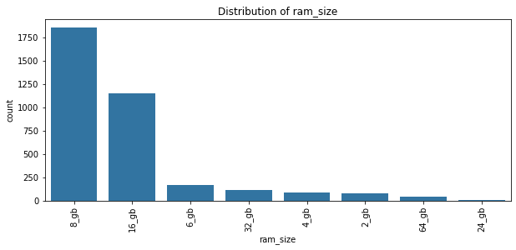
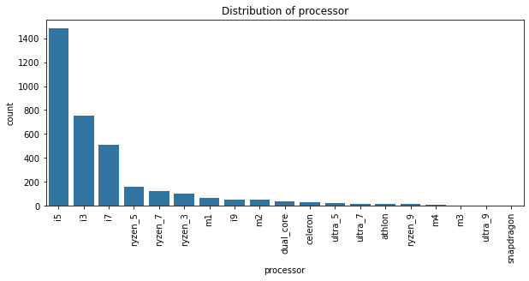
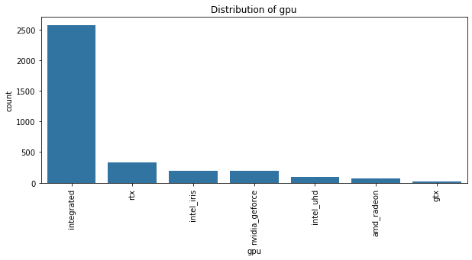
Plots

Slide 11
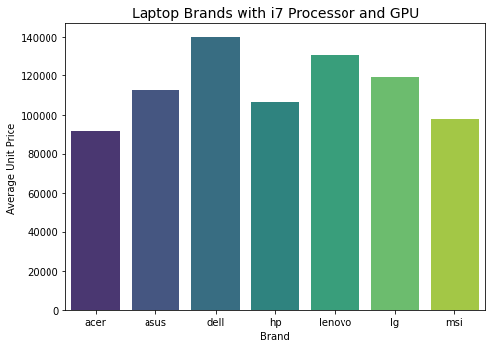
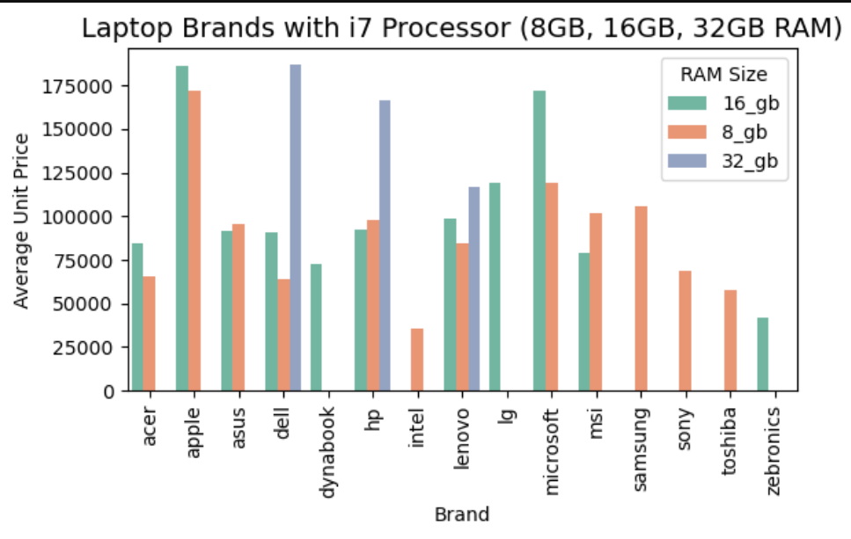
Average prices by brand (for i7 + GPU laptops)
Brands: MSI, HP, Lenovo, ASUS, Dell, Acer, LG.
Dell → ₹1,39,834 (highest)
Lenovo → ₹1,30,311
Asus → ₹1,12,823
LG → ₹1,18,987
HP → ₹1,06,403
MSI → ₹97,894
Acer → ₹91,198 (lowest)
Average prices by brand (for i7 + 8, 16, 32, gb Ram laptops)
Highest priced:
Dell (32GB) ~₹2.23L
Apple (16GB) ~₹1.86L
HP (32GB) ~₹1.51L
Mid-range:
Lenovo & Asus (8–16GB) ~₹95K–1.1L
HP & Dell (8–16GB) ~₹90K–1.1L
MSI (8–16GB) ~₹73K–93K
Budget:
Acer (8–16GB) ~₹65K–73K
Sony (8GB) ~₹69K
Toshiba (8GB) ~₹58K
Zebronics (16GB) ~₹42K (cheapest)

Slide 12
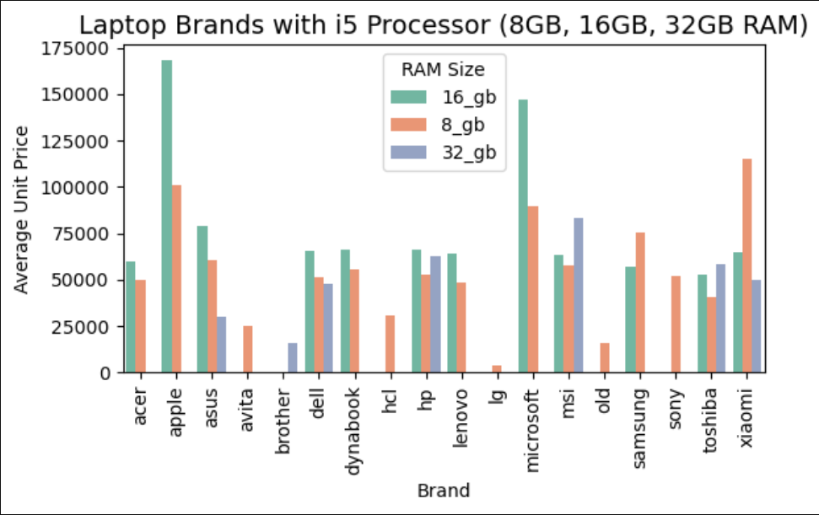
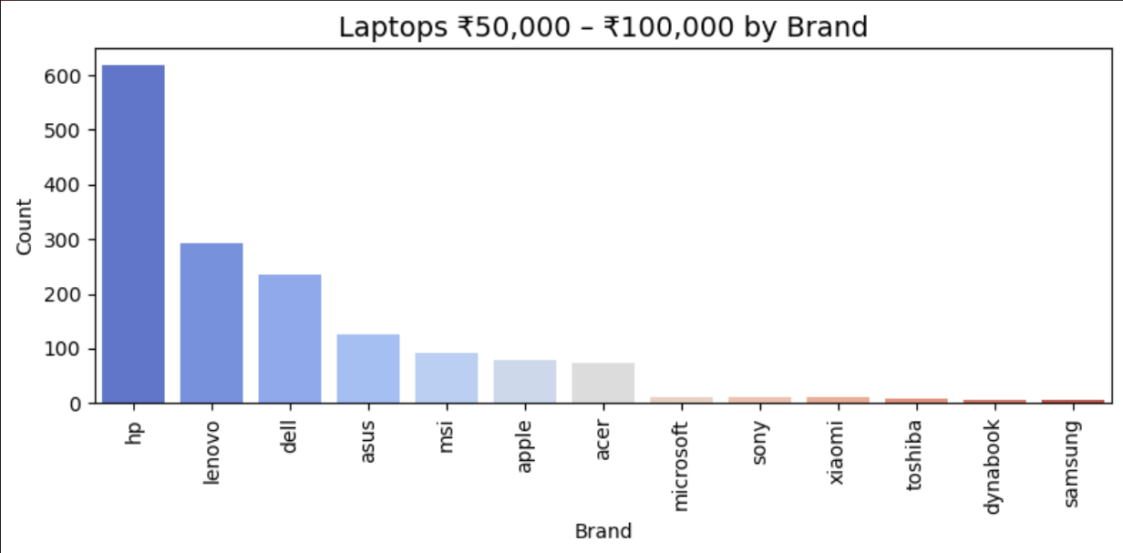
Average prices by brand (i5 + 8GB, 16GB, 32GB RAM)
Apple
16GB → 168,617
8GB → 101,153
Microsoft
16GB → 147,344
8GB → 89,825
HP, Dell, Lenovo, Acer → ~50,000 – 66,000
Budget brands
Avita → 25,000
Old → 16,000
Brother → 15,700
LG → ~4,000
MSI & Asus → mix of ~60,000 (mid-range) and ~80,000+ (premium)
Xiaomi → inconsistent
16GB → 65,000
32GB → 50,000
8GB → 115,000
Laptops priced between ₹50,000 and ₹100,000
Lower mid-range (~50,000–60,000): HP, Lenovo, Dell i5 laptops (8GB–16GB RAM).
Mid (~65,000–75,000): HP, Dell, Lenovo i5/i7 with 16GB RAM.
Upper mid (~80,000–100,000): Asus, MSI, Apple entry-level MacBooks, Microsoft Surface.

Slide 13
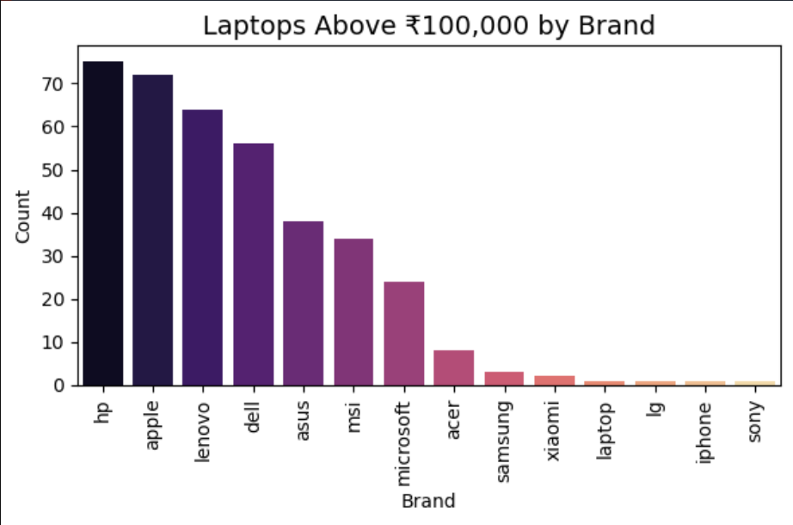
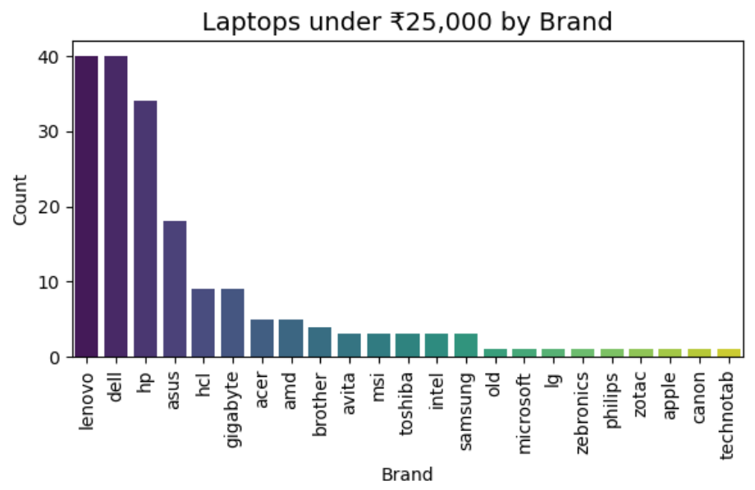
Laptops above 1000,000
₹1.01L – ₹1.2L: HP i7, Acer i5, Samsung i5/i7.
₹1.2L – ₹1.8L: Asus ROG, MSI, Sony Ryzen, higher HP Pavilion/Envy.
₹1.5L – ₹2L+: Microsoft Surface, Apple M2/M3 models.
₹2.5L+: Apple high-end M4, workstation laptops.
Laptops above 25k
Under ₹25k → Budget laptops (HP, Lenovo, Dell, Acer) | 4–8GB RAM | 256–512GB storage.
₹50k–₹1L → Mid-range (HP, Dell, Lenovo, MSI) | i5/i7 | 8–16GB RAM | 512GB–1TB.
Above ₹1L → Premium (Apple, Microsoft, Asus, Samsung, HP) | i7/M-series | 16–32GB RAM | High storage.

Slide 14
Conclusion
Conclusion from Your Data
Budget Segment (<₹25k)
Brands: HP, Lenovo, Dell, Acer, Technotab, Old
Specs: 4–8GB RAM, 256–512GB storage, all integrated GPUs.
HP Athlon (8GB/256GB) ₹21k,
Lenovo i7 (16GB/1TB) surprisingly cheap at ₹17k.
Mostly basic usage laptops, with some unusual pricing (like i7 under ₹20k).
Premium Segment (>₹1L)
Brands: HP, Microsoft, Apple, Asus, Samsung, Sony, Acer
Specs: 8–64GB RAM, 512GB–1TB storage, mix of integrated & dedicated GPUs (RTX/GTX).
Apple M4 (8GB/1TB) ₹2.78L,
Microsoft Snapdragon (16GB/512GB) ₹1.59L,
HP i7 with RTX ₹1.09L.
These are high-performance & luxury laptops;
Apple clearly sits at the very top in pricing.
Insights
HP & Lenovo → appear in both budget and premium ranges, showing wide market coverage.
Apple & Microsoft → only appear in premium, targeting high spenders.
Technotab & Old brands → only show up in low-price segment, with very cheap units (even ₹5,499).
Some data seems (e.g., i7 laptops below ₹20k), suggesting either second-hand/refurbished listings or mispriced entries.

Slide 15

THANK YOU

